Slide 1
Iterative and Incremental Development

Slide 2
Introduction
Iterative and incremental software development is a method of software development that is modeled around a gradual increase in feature additions and a cyclical release and upgrade pattern.
Iterative and incremental software development begins with planning and continues through iterative development cycles involving continuous user feedback and the incremental addition of features concluding with the deployment of completed software at the end of each cycle.
It is one of the methodologies of Agile software development, rational unified process and extreme programming.

Slide 3
Introduction
Iterative and incremental development is a discipline for developing systems based on producing deliverables.
In incremental development, different parts of the system are developed at various times or rates and are integrated based on their completion.
In iterative development, teams plan to revisit parts of the system in order to revise and improve them. User feedback is consulted to modify the targets for successive deliverables.
Iterative and incremental software development came about in response to flaws in the waterfall model, a sequential design process in which progress flows steadily downwards.
It differs from the waterfall model because it is cyclical rather than unidirectional, offering a greater ability to incorporate changes into the application during the development cycle.

Slide 4
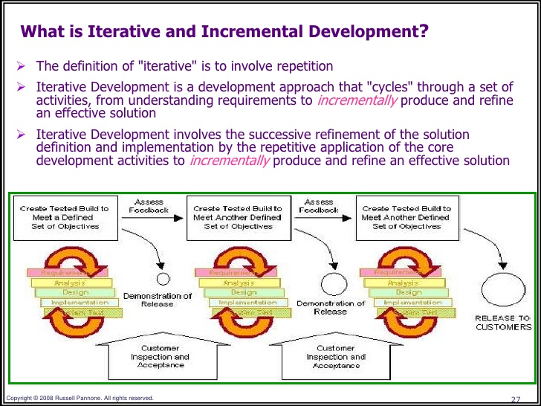
Introduction

Slide 5
Phases
Inception Phase:
Deals with the scope of the project, requirements and risks at higher levels
Elaboration Phase:
Delivers working architecture that moderates risks identified in the inception phase and satisfies nonfunctional requirements
Construction Phase:
Fills in architecture components incrementally with production-ready code, which is produced through the analysis, implementation, design and testing of functional requirements
Transition Phase:
Delivers the system to the production operating environment

Slide 6

Life Cycle Phase
The engineering stage –
driven by smaller teams doing design and synthesis activities.
2. The production stage –
driven by larger teams doing construction, test, and deployment activities
Engineering Stage
Production Stage
Inception
Elaboration
Construction
Transition
Idea
Architecture
Beta Releases
Products

Slide 7
Inception Phase
Overriding goal – to achieve concurrence among stakeholders on the life-cycle objectives
Essential activities :
Formulating the scope of the project (capturing the requirements and operational concept in an information repository)
Synthesizing the architecture (design trade-offs, problem space ambiguities, and available solution-space assets are evaluated)
Planning and preparing a business case (alternatives for risk management, iteration planes, and cost/schedule/profitability trade-offs are evaluated)

Slide 8
Elaboration Phase
During the elaboration phase, an executable architecture prototype is built
Essential activities :
Elaborating the vision (establishing a high-fidelity understanding of the critical use cases that drive architectural or planning decisions)
Elaborating the process and infrastructure (establishing the construction process, the tools and process automation support)
Elaborating the architecture and selecting components (lessons learned from these activities may result in redesign of the architecture)

Slide 9
Construction Phase
During the construction phase :
All remaining components and application features are integrated into the application
All features are thoroughly tested
Essential activities :
Resource management, control, and process optimization
Complete component development and testing against evaluation criteria
Assessment of the product releases against acceptance criteria of the vision

Slide 10
Transition Phase
The transition phase is entered when baseline is mature enough to be deployed in the end-user domain
This phase could include beta testing, conversion of operational databases, and training of users and maintainers
Essential activities :
Synchronization and integration of concurrent construction into consistent deployment baselines
Deployment-specific engineering (commercial packaging and production, field personnel training)
Assessment of deployment baselines against the complete vision and acceptance criteria in the requirements set

Slide 11
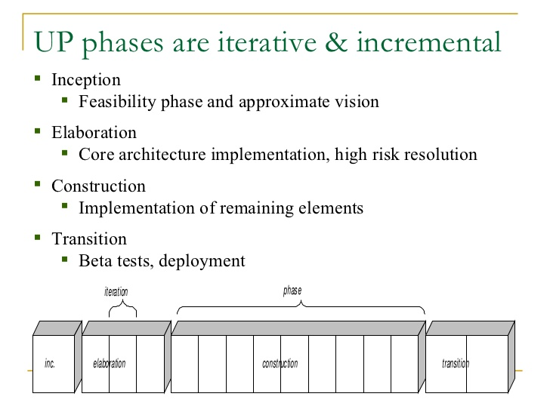
Phases

Slide 12
Evaluation Criteria :
Is the user satisfied?
Are actual resource expenditures versus planned expenditures acceptable?
Each of the four phases consists of one or more iterations
in which some technical capability is produced in demonstrable
form and assessed against a set of the criteria
The transition from one phase to the next maps more
to a significant business decision than to the completion of
specific software activity.

